Slide 1

FLE (0500)
Directed Writing
(Exams in 2027-2029)

Slide 2


Evaluate these statements.
This House Would…
This House Regrets…
This side supports This side disputes

Slide 3

The Earth is a flat disk

Slide 4

Pugs are ugly not cute.

Slide 5
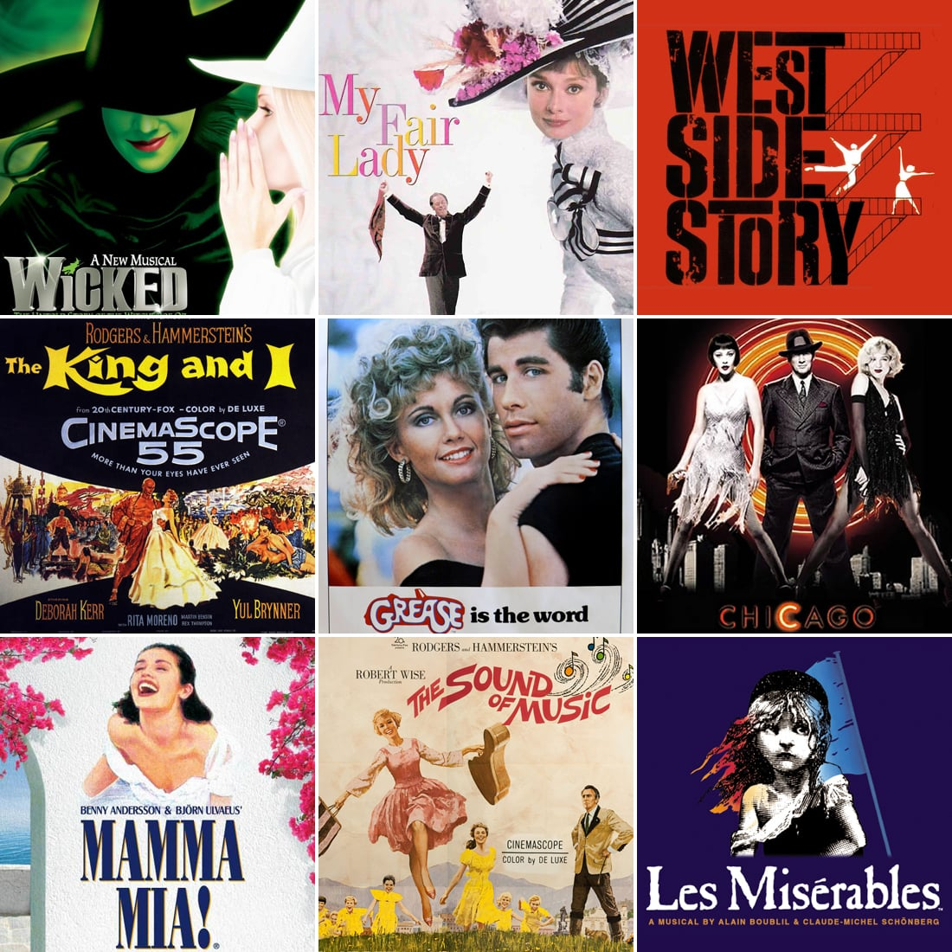
Musicals are just awful! All that bursting into spontaneous song will not bring about world peace or save humanity

Slide 6

Taylor Swift is overrated

Slide 7

Fortnite should be cancelled in 2026!

Slide 8
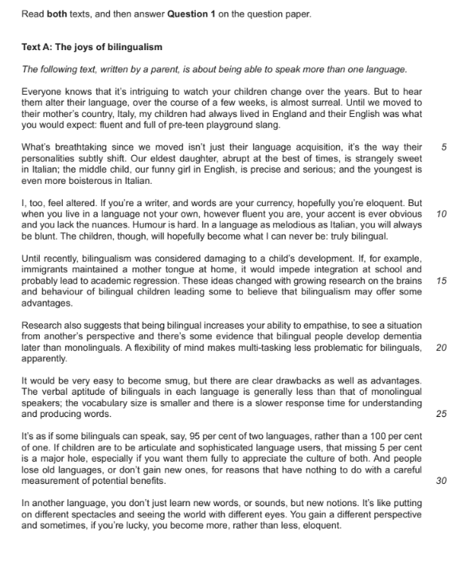
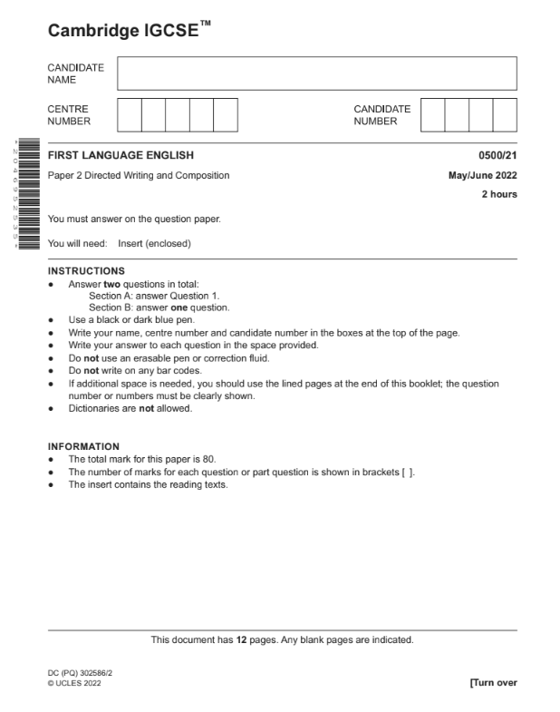
Lesson Learning Ex.
Your baseline assessment was on the 2nd part of the FLE Paper 2, Writing Paper
SECTION A: Directed Writing
SECTION B: Composition Writing
We did this!
Now we will have a little look at Directed Writing, before we begin Romeo and Juliet next week!
Consolidating understanding of FLE Paper 2
P2 FLE - Writing Paper Practise- Composition>Directed

Slide 9
Create your own unpopular opinion!

Slide 10
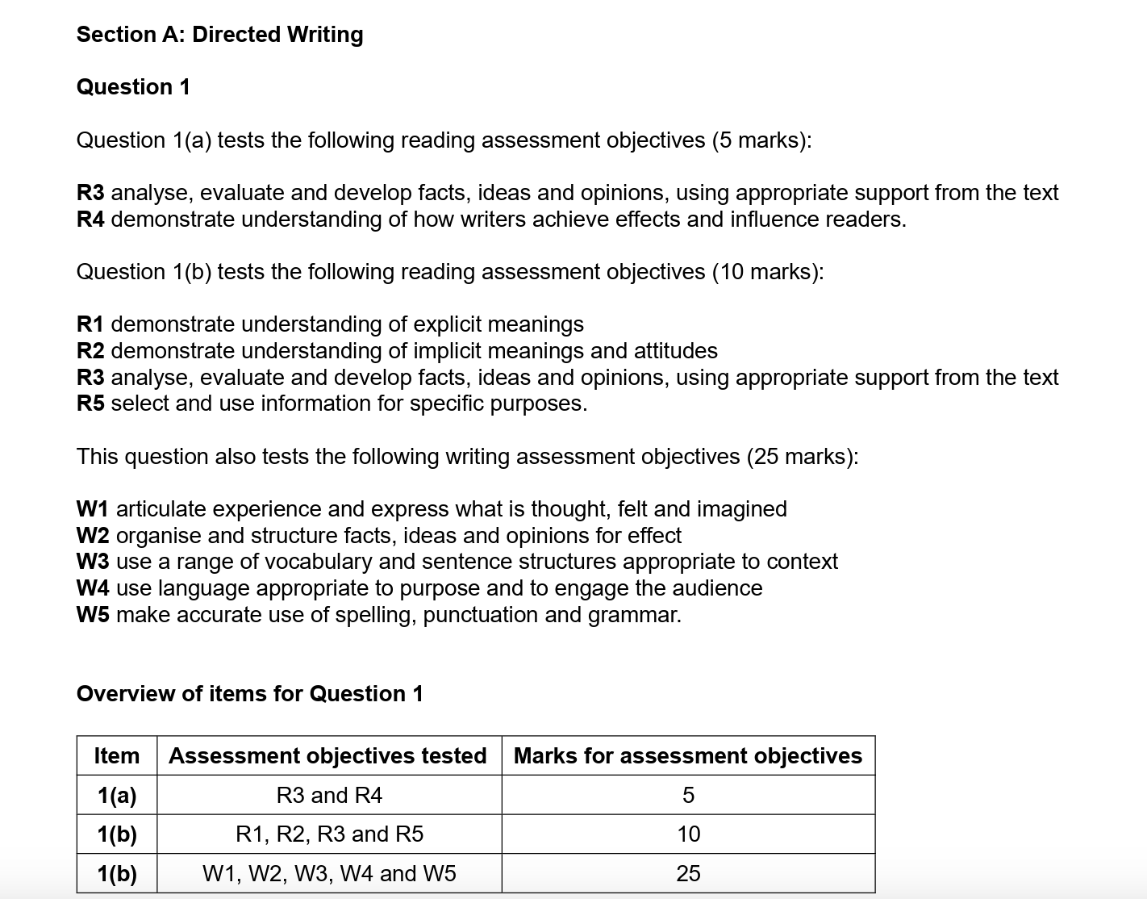
What is Directed Writing?
Directed Writing (Section A of the Writing Paper) will ask you to read 1 or 2 non-fiction extracts and answer 1 question in 2 parts.
Question 1a) asks you to evaluate the writer’s views in a particular part of one of the extracts. (5 marks)
Question 1b) asks you to write your own persuasive/ discursive written response in the form of a letter, speech, article or report, based on what you have read in the extract(s) (10 marks for reading; 25 marks for writing).
This first part of the writing paper assesses both your reading for meaning and your writing skills.
You have 1 hour to answer this part of the paper.
Total of 40 marks available for Section A Directed Writing

Slide 11
NOTE: This is the same skill assessed in Question 2b of the FLE Reading Paper.
Directed Writing - Sample Mark Scheme
Question 1a) - 5 marks
Table A - Reading
Level | Marks | Description
3 | 4-5 | Clear understanding of the attitude expressed in the extract with relevant support from the text. (R3, R4)
2 | 2-3 | Some understanding of the attitude expressed in the extract with some supporting detail. (R3, R4)
1 | 1 | Limited understanding of the attitude expressed in the extract. (R3, R4)

Slide 12
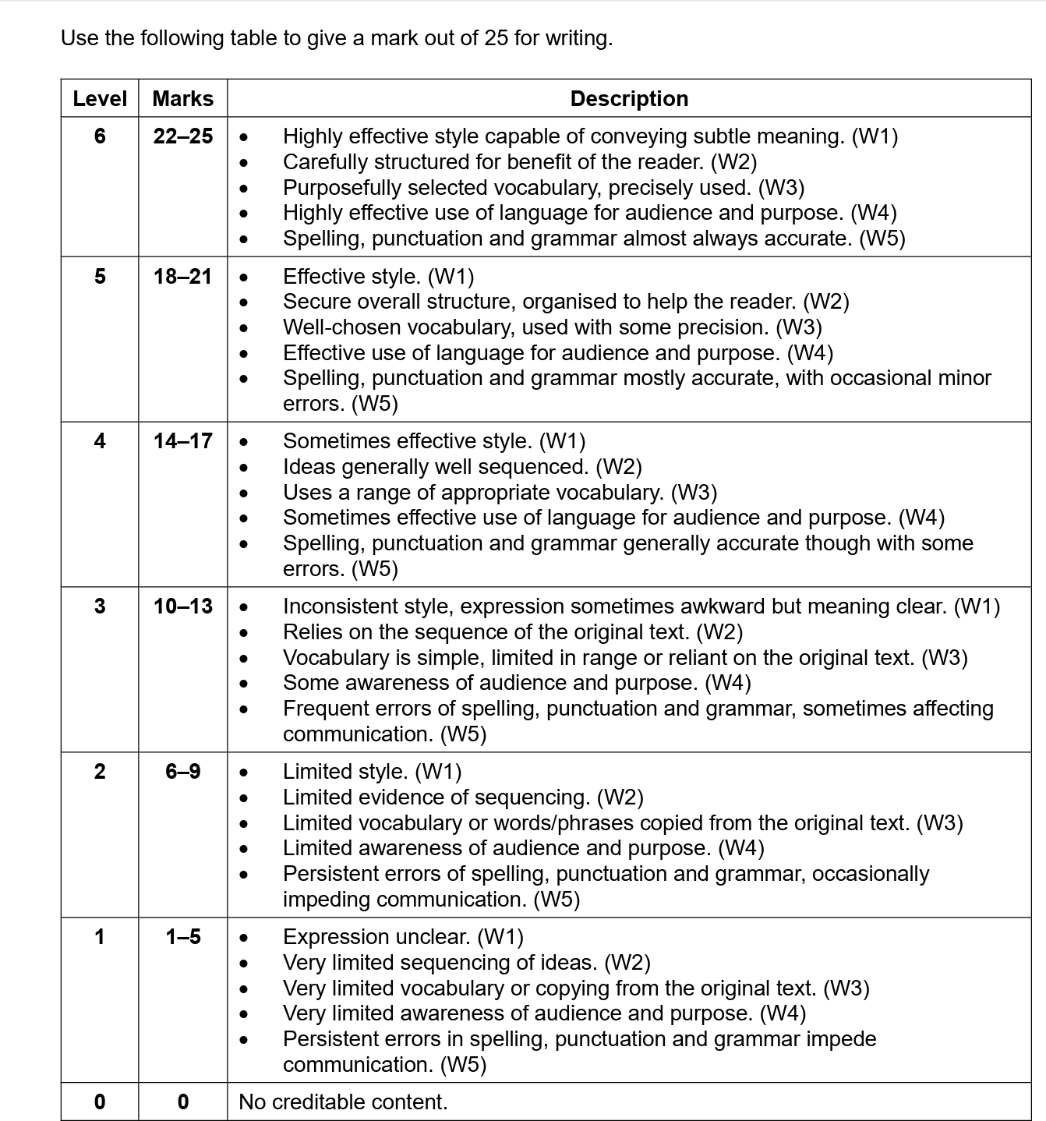
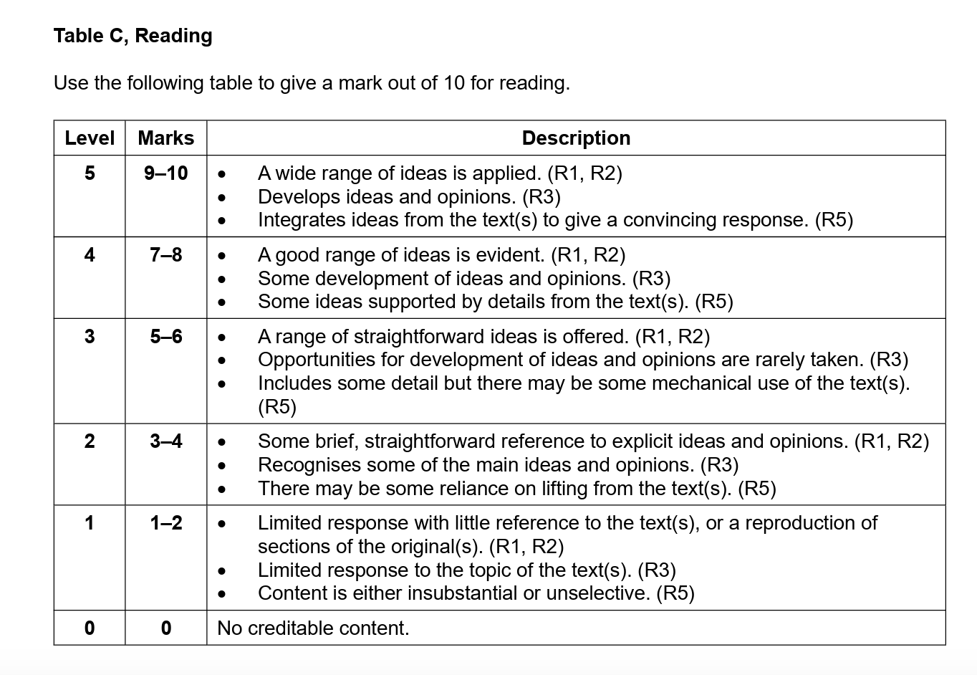
Directed Writing - Sample Mark Scheme
Question 1b) - 35 marks
10 marks for reading
25 marks for writing
Table B, Writing

Slide 13
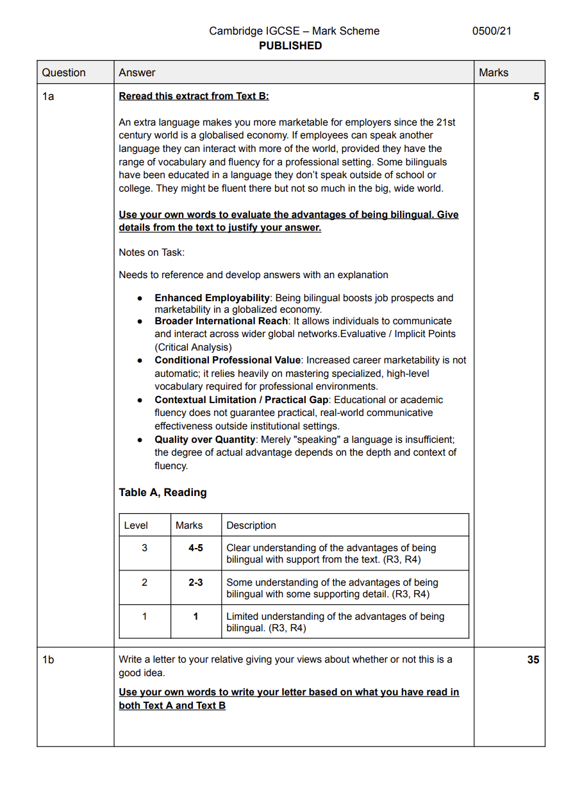

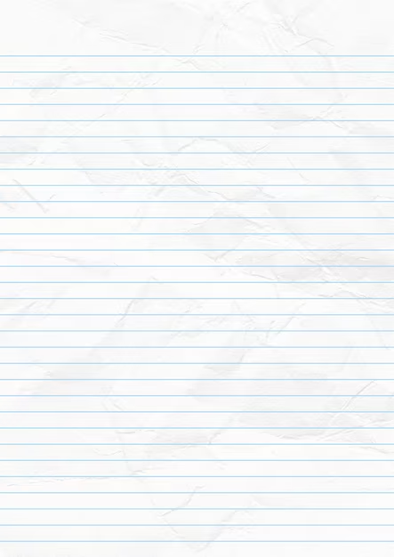
Directed Writing - Ex. Mark Scheme
Carefully read through and review
the mark scheme when peer marking
1 laptop between two

Slide 14


What will you have to read and write about?
GLOBAL ISSUES
Issues and topics affecting and impacting young people and adults in the 21st century.
These issues are experienced across countries, cultures, and across time.
Example of a global issue: the consequences of buying clothes from ‘fast fashion’ retailers
Can you think of another example?

Slide 15


What form/ text type could you be asked to write in for
Directed Writing Question 1b)?
In Question 1(b) candidates use, develop and evaluate the information in the extract(s) to create a discursive / argumentative / persuasive speech, letter, article or report.
Note:
On the Reading Paper Question 4, you also might be asked to write the words of an interview or journal entry! You will need to know the conventions of these text types too!
LETTER (informal or formal)
ARTICLE
SPEECH
REPORT
What are the conventions of these different text types?
Create an infographic on the text type allocated to your pair/ group of three.
Add to the infographic the features of your text type:
Purpose and audience
Format and layout
Register and tone
Key persuasive/ discursive techniques to use, e.g. rhetorical questions, direct address, etc.
Use images, icons and bullet points to help make the information simple to read and easy to understand on your infographic.
Notes:
If time, students could present their infographic to the class.

Slide 16
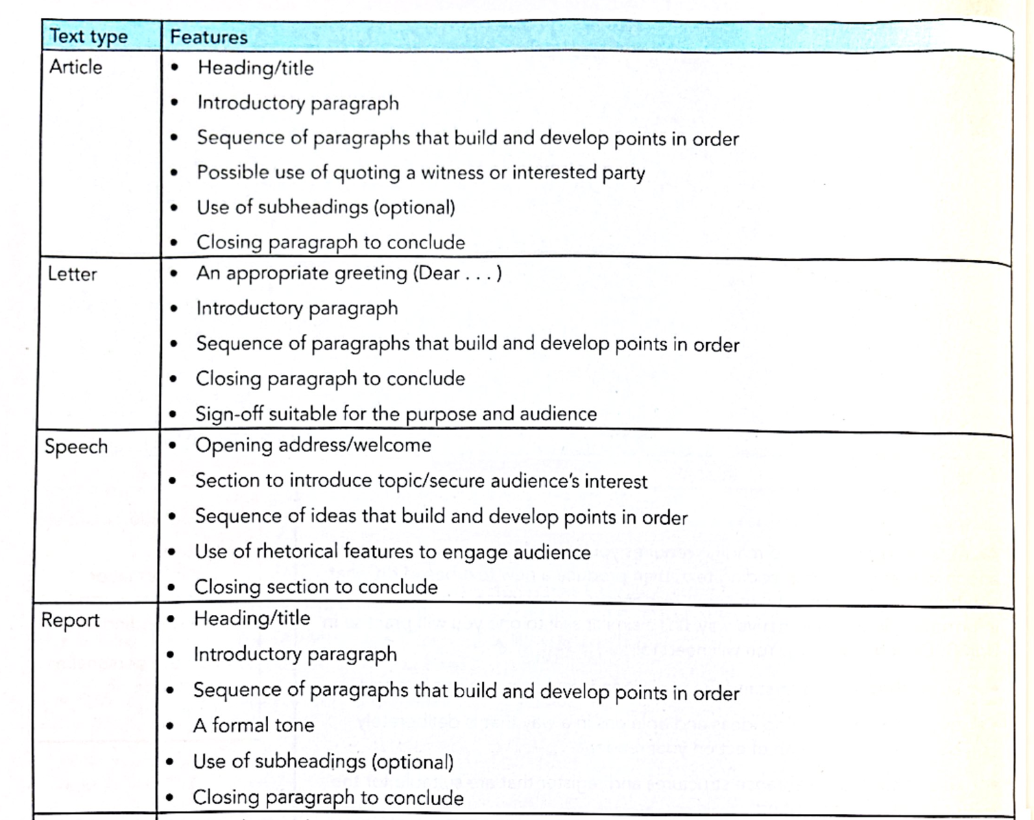
Text Types pages - orange text book.pdf - information on the 4 text types to help make the infographic.

Slide 17
Quick Recap Quiz!
Directed Writing - Section A
How long will you have for this Section A of the FLE Writing Paper?
How many marks is question 1a) worth?
How many marks for reading are available in question 1b)?
How many marks are available for writing in question 1b)?
Bonus Question: What is in Section B of the FLE Writing Paper?

